Slide 1
Mirra Alfassa
How Women Change the World

Slide 2
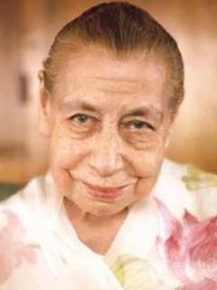
Mirra Alfassa (21 February 1878 – 17 November 1973), known to her followers as The Mother, is a spiritual guru, and a collaborator of Sri Aurobindo, who considered her to be of equal yogic stature to him and called her by the name "The Mother". She founded the Sri Aurobindo Ashram and established Auroville as a universal town; she was an influence and inspiration to many writers and spiritual personalities on the subject of Integral Yoga.
Notes:
What is Yogic Stature?: It is a measure of one’s level of consciousness
What Is Consciousness?: You are conscious of your body, thoughts etc. Are you conscious of what I am thinking? If you expand your consciousness, you can know. It is Awareness.
What is Integral Yoga?: Yoga is the Union with God. Integral Yoga means that the Union is complete at all levels.
What are the different levels?: Physical, Vital, and Mental.
What is Vital? It is your will-power, aspirations, ambitions, dynamisms, complexity. Complexity or richness of your personality.

Slide 3
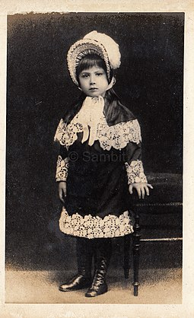
THE SCIENCE OF LIVING
To know oneself and control oneself
Mother started a school in Pondicherry which focuses on integral development of the child.
Integral Education emphasises equal importance to different aspects of learning.
Notes:
Integral Development = Education for the body, mind and soul. Music and art are examples of education for the soul.

Slide 4
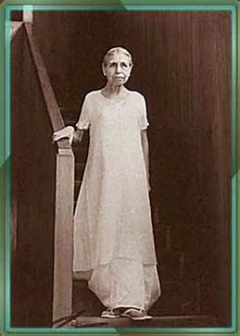
Education begins at…
She taught us that the education of a human being should begin at birth and continue throughout our lives.
Education to be complete must have these aspects corresponding to the 5 activities of the human being: the physical, the vital, the mental, the psychic, and the spiritual.
Education of all these activities must continue, completing one another, throughout our lives.

Slide 5
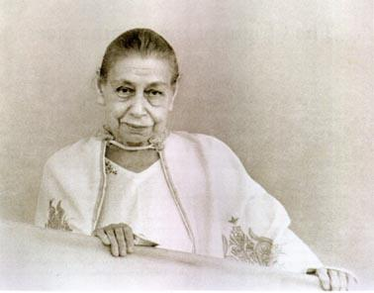
Physical Education
Physical education has 3 aspects:
Control and discipline of the functioning of the body.
An integral, methodical, and harmonious development and movements of the body.
Corrections of any defects and deformities.
Notes:
Body should be flexible. If your body bends properly, like in some asanas, where you have to bend backwards and touch the floor with your palms, then your body is functioning properly. There are other functions of the body too.

Slide 6
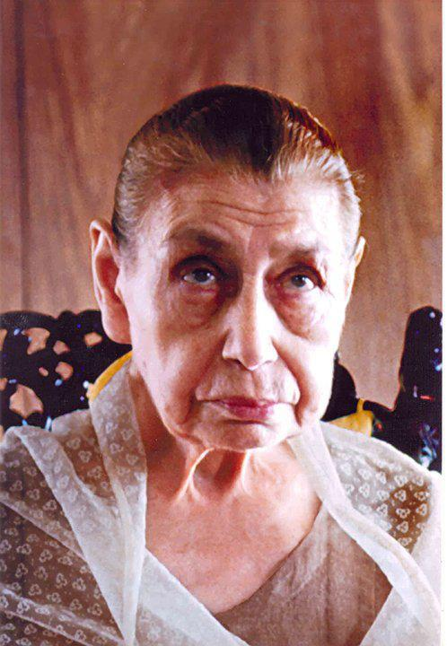
Vital Education
Vital holds power, energy, enthusiasm and effective dynamism. But nothing can satisfy it and it’s demands are without limit.
The indispensable starting-point is a detailed observation of the character to be transformed.
Notes:
What is effective dynamism?: When you set a goal, you should know how to achieve that goal. What effort goes into making that goal a success.
What is Vital?: Ok, PS5 has come out. I WANT IT. I WANT IPHONE 13. You get the idea.
What is the indispensable starting-point?: Something you cannot do without.

Slide 7
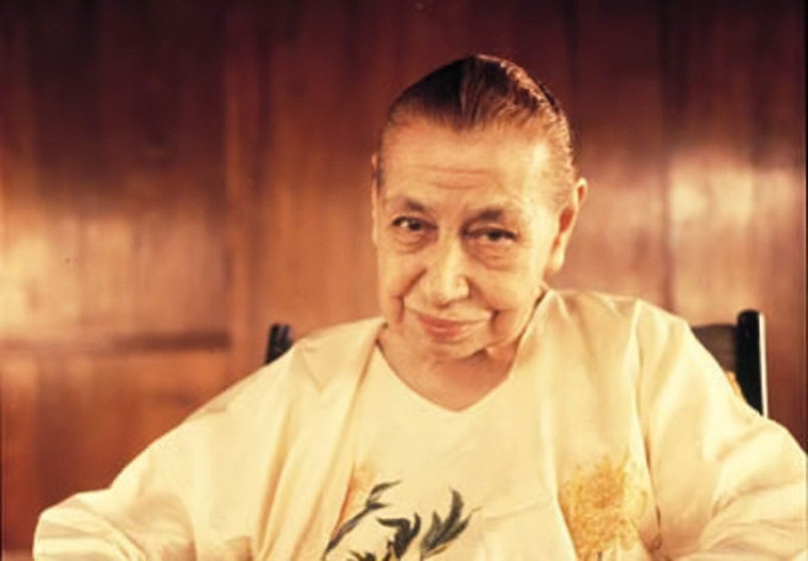
Mental Education
A true mental education has 5 phases:
Development of the power of concentration, the capacity of attention.
Development of the capacities of widening, complexity and richness.
Organisation of one’s idea around a central idea, that will serve as a guide in life.
Thought control, rejection of undesirable thoughts, to become able to think only what one wants and when one wants.
Development of mental silence, perfect calm and total receptivity to inspirations.
Notes:
2nd Point: Tell Leonardo Da Vinci. He’s touched field.
The central idea: If you want to be successful in life, you must have an aim. That aim is the Central idea. There may be other ideas or goals but the central idea DOES NOT CHANGE.

Slide 8
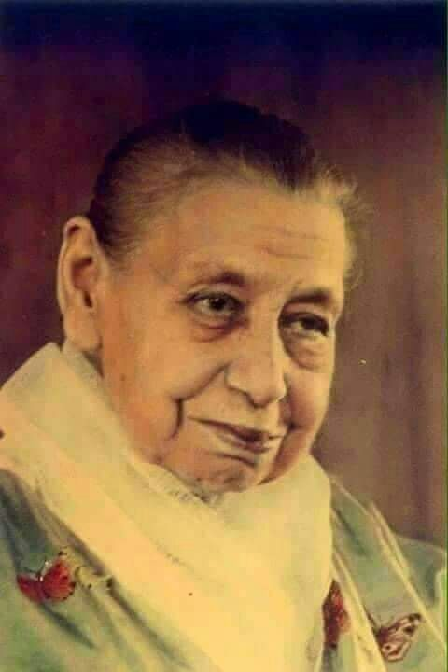
PSYCHIC AND SPIRITUAL EDUCATION
Every human being carries hidden within him/her the possibility of a greater consciousness. Indeed, in all exceptional beings it is always this consciousness that governs their lives and organises both the circumstances of their existence and their individual reaction to these circumstances. What the human mental consciousness does not know and cannot do, this consciousness knows and does. It is like a light that shines in the centre of the being.
Notes:
Individual reaction to these circumstances: Different people react to one situation differently. This is because their level of consciousness is different.

Slide 9
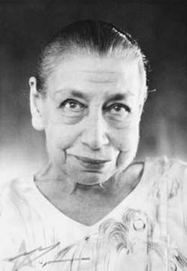
TO THE STUDENTS, YOUNG AND OLD
If you are bored of school, or a subject, instead of saying, ”How boring it is going to be!”, you should tell yourself, “There is not a single minute or circumstance that is not an opportunity for progress. So what progress am I going to make today? So I shall try, I shall listen carefully, concentrate hard, and above all, drive out of my mind this aimlessness, this superficial shallowness”
Notes:
What is Vital?:

Slide 10
All excerpts are taken from the book, “On Education” by The Mother. For further reading, one can buy this book from the school Bhavan.

Slide 11
The Mother started the Centre of Education in Pondicherry. AMIS is a branch of the same.

Slide 12
Notes:
How did The Mother change the world?:
Evolution on earth started with basic life forms like bacteria, then multi-cellular organisms, amphibians, birds, reptiles, apes, and finally human beings. But wait! Do you really think human beings are final? She did a lot of work preparing for the next step in evolution. To read more about it, go to our school Bhavan and pick up a book that explains in detail her contribution to this upcoming step in evolution.

